Slide 1


Ryan Record’s considerably terrible, very dreadful and god awful Power point presentation about Persuasion
For your health

Slide 2
Persuasion is the process of influencing your audience to agree with your point of view, recommendation, or request.
First you must plan your message…
What is your purpose?
Who is the audience?
How will you do it?
What is the best medium of communication?
One on One?
Face to Face?
Text or Email?
What is you desired result?
In a group or by carrier pigeon?
Just Remember,
APPEAL TO YOUR AUDIENCES EMOTIONS
To create a persuasive message, focus on the audience’s
information needs,
motivation and benefits, and
potential resistance.

Slide 3
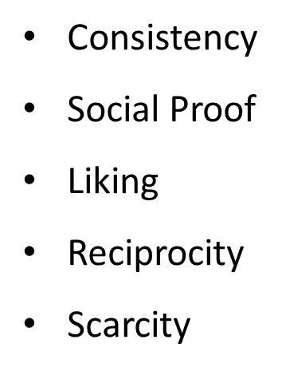
Aristotle’s Three Elements of Persuasion
Building credibility (ethos)
  Credibility – An audience’s belief that you have expertise and are trustworthy based on your knowledge, character, reputation, and behavior.
Constructing a logical argument (logos)
  Present logical arguments and evidence to support a decision.
    Numerical data, Facts, Expert authority, Personal experience, Examples
Appealing to your audience’s emotions (pathos)
  Appeal to your audience’s emotional and psychological needs.
  Make appeals based on widely studied psychological principles.
  Show your own emotional commitment.
  Use storytelling and powerful language to make evidence compelling.
Maslow’s Hierarchy of Needs
All people – even those of different cultures and generations – share a common set of needs

Slide 4



Avoid logical fallacies
Examples include:
Logical fallacies occur when you overstate your case, divert attention from problems with your position, or attack an opponent. Avoid fallacies in and recognize them when others use them against you so that you are not persuaded by unsound ideas.
Fallacies are bad, Mmmkay.

